Slide 1


Object Oriented Programming with JAVA
Department of Computer Science & Engineering, PIET

Slide 2


UNIT-3
Control Statements

Slide 3
Control Statements
Control statements are a fundamental part of programming in Java, as they allow you to control the flow of execution in your program. They enable you to make decisions and perform repetitive tasks based on certain conditions or criteria.
Control statements in Java are divided into three categories:
Conditional Statements
Looping Statements
Jump Statements

Slide 4
Conditional Statements
Conditional Statements are used to execute different blocks of code based on certain conditions. They are also known as decision-making statements.
Conditional Statements in Java are of three types -
if statement
if-else statement
switch statement

Slide 5
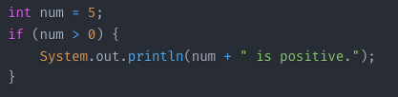
if Statement
The if statement is the simplest conditional statement.
It executes a block of code if the specified condition is true.

Slide 6
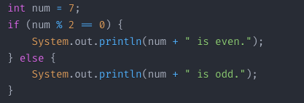
if-else Statement
The if-else statement provides an alternative block of code to execute if the condition is false.

Slide 7
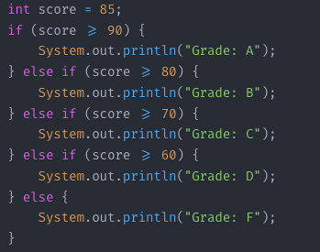
Nested if-else Statement
Nested if-else statements are used when you need to check multiple conditions.
Inner if-else statements are nested within outer if-else statements.

Slide 8
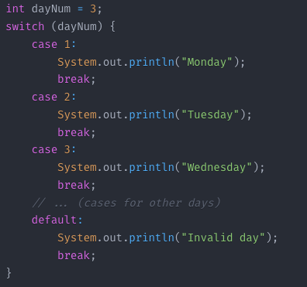
switch Statement
The switch statement is an alternative to nested if-else statements.
It evaluates an expression and executes the associated block of code (case) based on the value of the expression.

Slide 9
Looping Statements
Looping Statements are used to execute a block of code repeatedly, based on certain conditions. They are essential for iterating over collections, arrays, or performing repetitive tasks.
There are four types of loops in Java
for loop.
Enhanced for loop.
while loop.
do-while loop.

Slide 10

for Loop
The for loop is used when the number of iterations is known in advance.
It consists of an initialization, condition, and iteration expression.

Slide 11
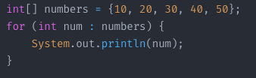
Enhanced for Loop (for-each)
The enhanced for loop (or for-each loop) is used to iterate over elements in arrays or collections.
It simplifies the process of iterating over each element in a collection.

Slide 12
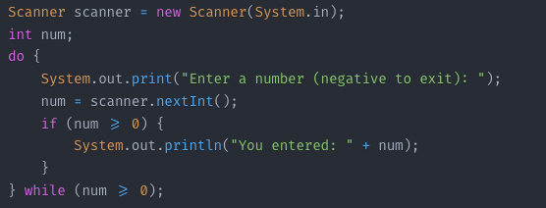
while Loop
The while loop is used when the number of iterations is unknown or depends on a condition.
The loop continues to execute as long as the specified condition is true.

Slide 13
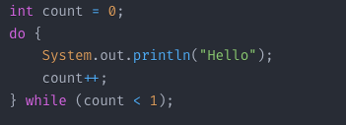
do-while Loop
The do-while loop is similar to the while loop, but it ensures that the loop body is executed at least once.
The condition is evaluated after the loop body is executed.

Slide 14
Jump Statements
Jump Statements are used to transfer control from one part of the program to another. They are often used to break out of loops or to skip iterations.
There are three types of jump statements in Java
break statement.
continue statement.
return statement.

Slide 15
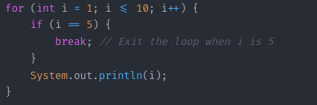
break Statement
The break statement is used to terminate the execution of the current loop or switch statement.
It transfers control to the statement immediately following the loop or switch.

Slide 16
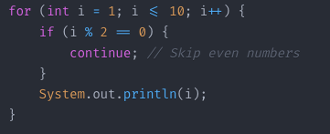
continue Statement
The continue statement skips the current iteration of a loop and moves to the next iteration.
It is often used to skip certain conditions within a loop.

Slide 17

return Statement
The return statement is used to exit a method and return control to the calling method.
It can optionally return a value if the method is not void.

Slide 18

www.paruluniversity.ac.in

